Slide 1
Spray Drift from Banded and Regular Spot Applications
Michael Bird and David Patterson
Date: 9th June 2025
Notes:
*For those reading after the 9th June, these slides make use of animations so are best viewed in Slideshow or Reading View*

Slide 2
Agenda
Context
Theory
Exploration
Next steps
Notes:
- I'll give you the context to where the idea for this novel method came from and what we want to achieve
- Next we'll go through the theory with both:
- Mathematics for the numerate
- Visuals of fields for the visual learners.
- Then we'll explore the potential reduction of spray drift compared to Full Field,
- I'll also briefly show an open source web app i've made so anyone can explore the methods presented here today.
- And finally I'll go over where we want to go next with this

Slide 3
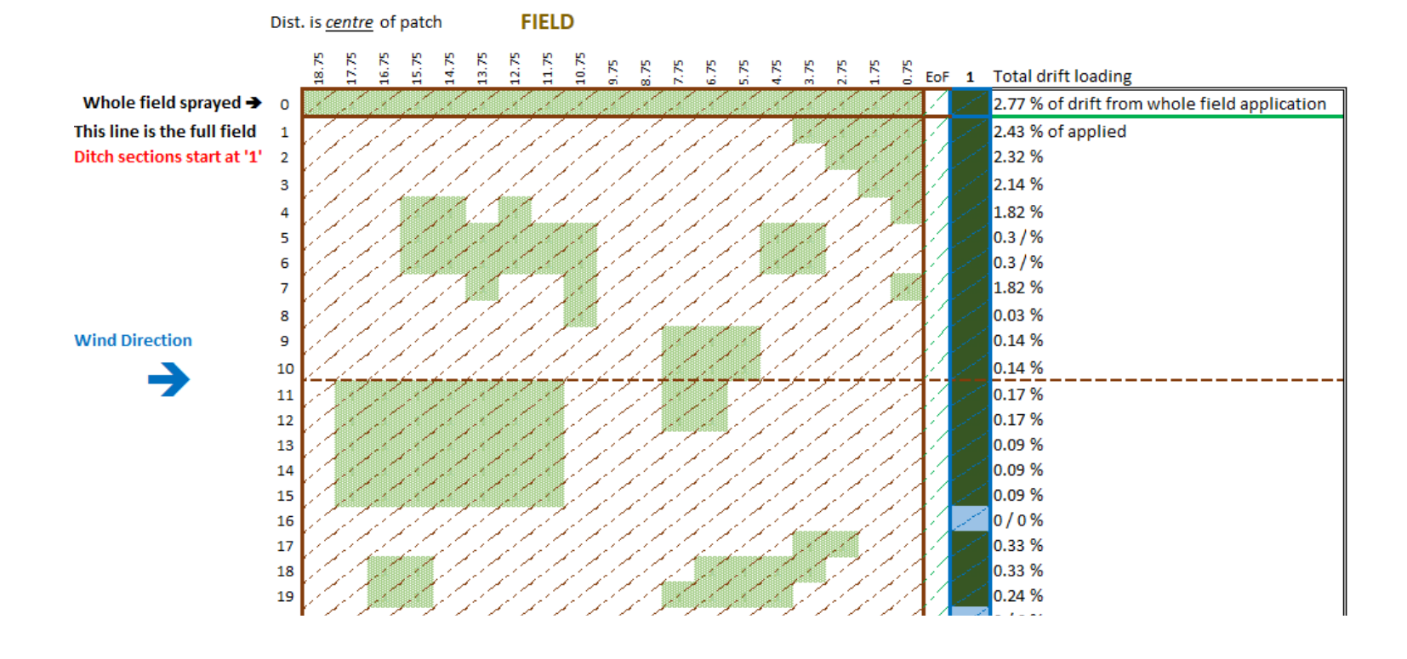
Context - Inspiration
This work was inspired and builds upon the work of Anastasiia Bolekhan, Andrew Chapple, Johannes Witt, and Prakash Srinivasan presented on behalf of Bayer in Piacenza, September 2024.
Drift was estimated from spraying 1x1m patches using SiMOD (Silsoe Spray Drift Model)
Drift from patches summed over rows perpendicular to water body
These spatially explicit loadings are then loaded into TOXSWA to investigate dispersion along the ditch and impact on aquatic risk assessment at different tiers (PEC_{max}, TWA₇, eco. Modelling)
Embedded PDF of Bolekhan 2024 – Slide 5 details their drift deposition methodology
TOXSWA Ditch
Screenshot of Bayer developed tool showing 1 x 1m grid resolution and horizontally summed drift.
Notes:
- This work was inspired by the work of some colleagues at Bayer; Anastasiia, Andrew, Johannes, and Prakash who presented at Piacenza last year about patch spraying and the subsequent loading of Pesticide into Toxswa.
- This visual in the bottom right got our imaginations going about how we could apply this further ...

Slide 4
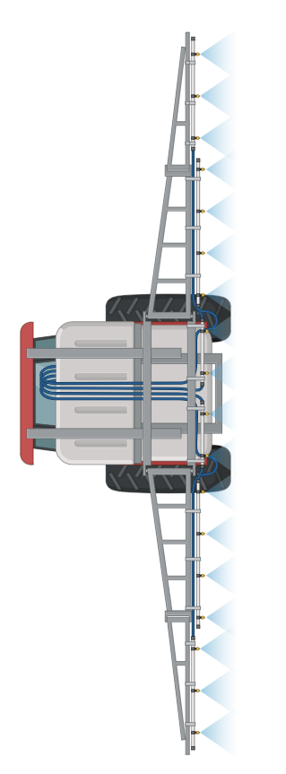
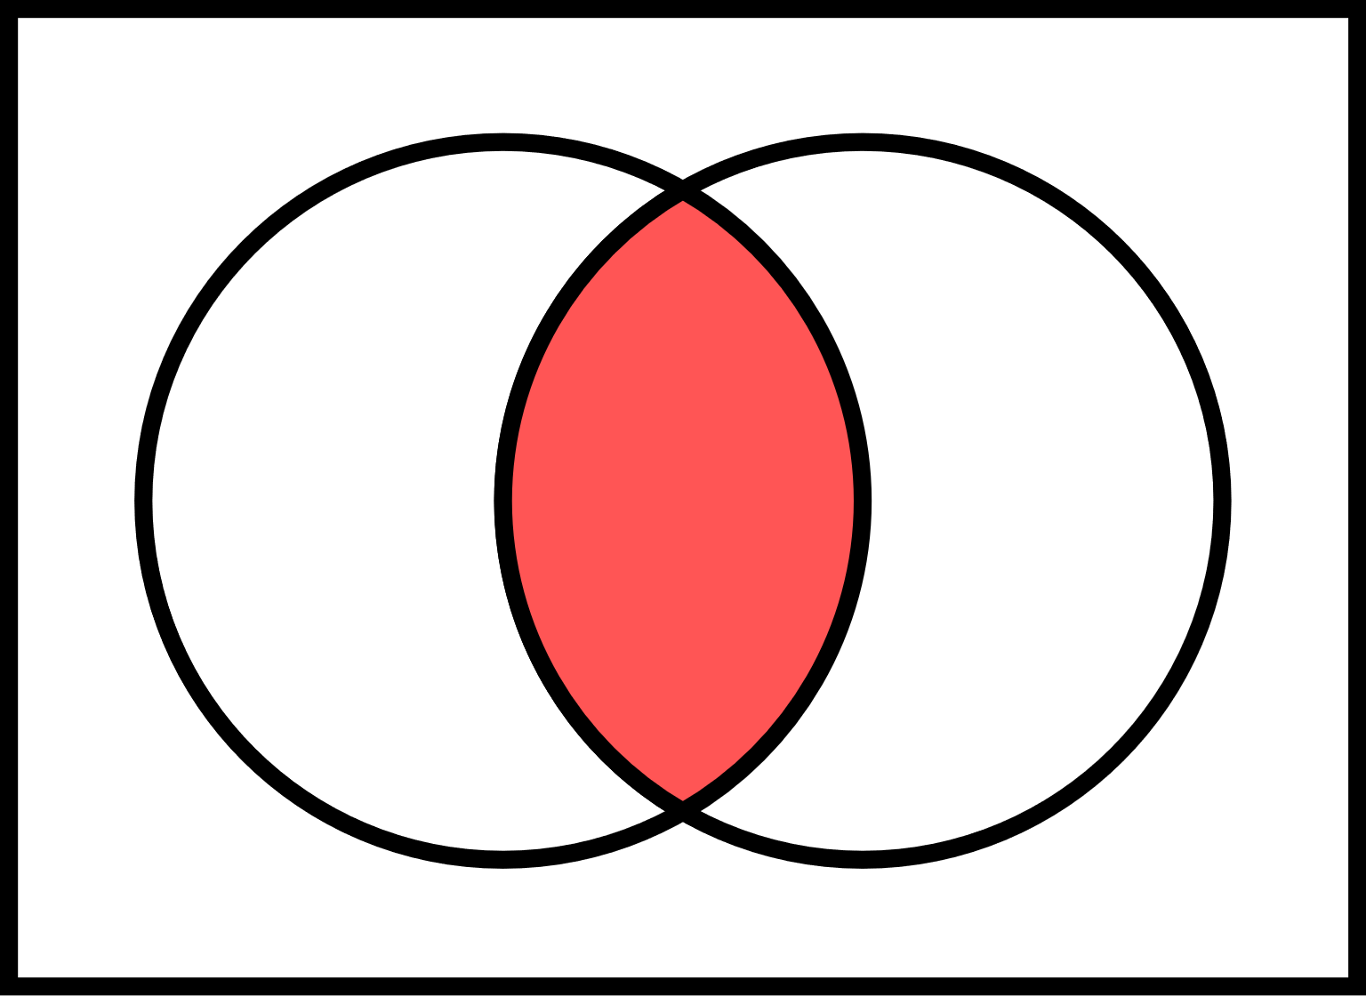
Context - Objectives
Row (Spray)
Inter-row (No Spray)
Water body
Can we:
Adapt this idea to Banded and Regular Spot applications
Make a “drift curve agnostic” approach
Calculate drift without having to limit to a fixed resolution.
Explore the drift reduction for various geometries (row and inter-row widths)
Provide information and tools for Risk Assessors and Regulators for evaluation
Banded (parallel)
Banded (perpendicular)
Regular Spot
Regular Spot application is the intersection of parallel and perpendicular banded application
Notes:
- We want to:
- Adapt this idea of patch drift to more structured application patterns, banded (parallel and perpendicular) and Regular spot
- Because different regulators (and crops) use different drift curves, it'd be ideal to keep the method able to use any drift curve.
- We also want to not have to discretise the field so we can calculate any geometry or row and inter-row width
- We want to be as open as possible to get feedback from our piers.
- A note on the graphics for today. We’ll use a lot of diagrams like these:
- Green equals the row being sprayed
- Brown equals the inter-row, not being sprayed
- Blue is surface water and today it's always on the RHS
- In this talk, we think of regular spot application mathematically as the intersection of parallel and perpendicular banded application. If you overlay-ed the top two fields, regular spot sprays where both banded applications spray.

Slide 5
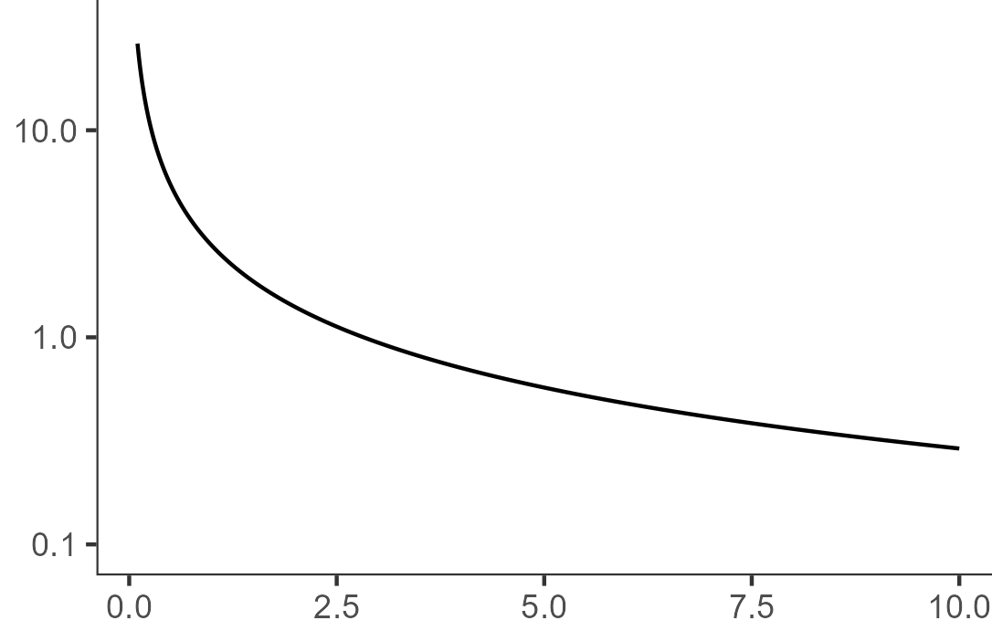

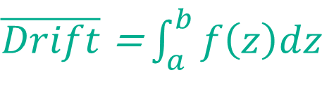

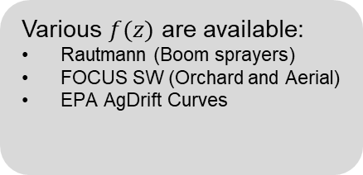



Theory – Drift Deposition Curves
% App. Rate
$$Drift\left(z\right)=f(z)$$
Various $f(z)$ are available:
Rautmann (Boom sprayers)
FOCUS SW (Orchard and Aerial)
EPA AgDrift Curves
$\overline{Drift}$ = $\int_{a}^{b}{f\left(z\right)dz}$
$$z$$
$$a$$
$$b$$
Distance Downwind (z)
Notes:
- Moving on to the theory now, most authorities estimate spray drift deposition via drift curves, these are empirically fitted mathematical functions that take distance from crop edge to return deposition as a percentage of full field rate.
- To estimate the total deposition over an area (ie a SW body) you can integrate this curve over the interval of the near and far edge of the water body measured from the crop edge.
- In Risk Assessment various drift functions (here called $f(z)$) and water body dimensions ($a$ and $b$) are used. Rautmann's curves are used in the UK and EU, the US use curves made for AgDrift. *These are all derived from full field applications*

Slide 6


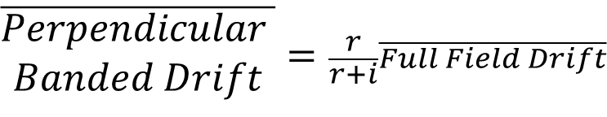

Theory – Perpendicular Band, old idea
Assume diffusion and water movement will lead to spray deposition to water body will be well mixed¹.
Scale deposition by % of vertical slice sprayed
$$r$$
$$r+i$$
$$i$$
$$\overline{\begin{aligned}Perpendicular \\ Banded Drift\end{aligned}}=\frac{r}{r+i}\overline{Full Field Drift}$$
¹ This is not a perfect assumption, as shown in Bayer’s presentation
Notes:
- If we wanted to estimate SW deposition from perpendicular bands we can make an okay assumption that pesticide mixes in the water body and scale our drift loading by the % of the field that gets sprayed.
- You can easily express that % as a function of row width and inter row width
- This is an old idea and quite easy to implement but parallel bands is a little harder

Slide 7
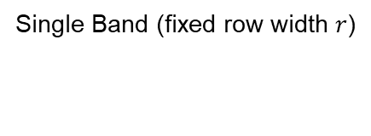
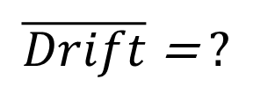
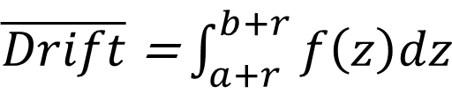
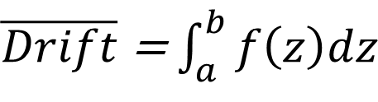
Theory – Parallel Bands, Novel Idea
Broadcast Application (Full Field)
Broadcast Application (Offset by row width r)
Single Band (fixed row width $r$)
$\overline{Drift}$ = $\int_{a}^{b}{f\left(z\right)dz}$
$\overline{Drift}$ = $\int_{a+r}^{b+r}{f\left(z\right)dz}$
$\overline{Drift}$ = $?$
Notes:
- The critical observation for this new approach is that deposition to SW from full field should be equal to the sum of the deposition from the field split in two.
- Here, we've split full field into a full field offset further away from the water, and a single band of width r

Slide 8
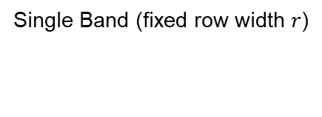
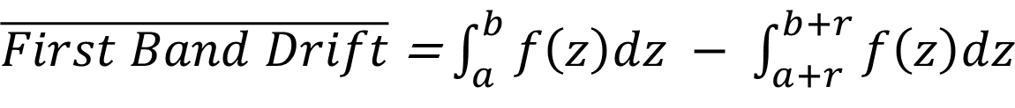

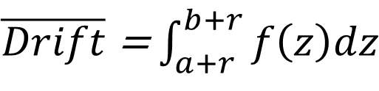
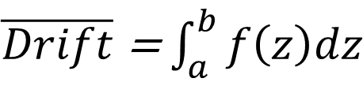
Theory – Parallel Bands, Novel Idea
Near / Right Side
Far / Left Side
Single Band (fixed row width $r$)
Broadcast Application (Full Field)
Broadcast Application (Offset by row width)
$$\overline{Drift}= ?$$
$\overline{Drift}$ = $\int_{a}^{b}{f\left(z\right)dz}$
$\overline{Drift}$ = $\int_{a+r}^{b+r}{f\left(z\right)dz}$
$\overline{First Band Drift}$ = $\int_{a}^{b}{f\left(z\right)dz} − \int_{a+r}^{b+r}{f\left(z\right)dz}$
Near / Right Side
Far / Left Side
Notes:
- We can rearrange this equation to give us the drift resulting from a single band at the edge of the field.
- Note: the drift from a single band is equal to full field drift up to the right side minus the full field drift up to the left side

Slide 9
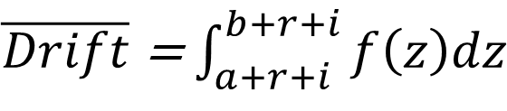
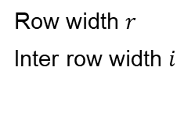
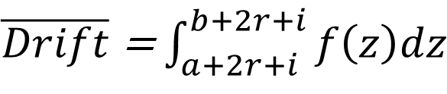
Theory – Parallel Bands, Novel Idea
Row width $r$
Inter row width $i$
$$\overline{Drift}= ?$$
$\overline{Drift}$ = $\int_{a+r+i}^{b+r+i}{f\left(z\right)dz}$
$\overline{Drift}$ = $\int_{a+2r+i}^{b+2r+i}{f\left(z\right)dz}$
$\overline{Second Band Drift}$ = $\int_{a+r+i}^{b+r+i}{f\left(z\right)dz} − \int_{a+2r+i}^{b+2r+i}{f\left(z\right)dz}$
Notes:
- This exact thing can be applied to another band further into the field
- This time the right side of the band is now offset by the row width of the first band plus the inter row width. the left side of the band is offset by two row widths and one inter row widths

Slide 10




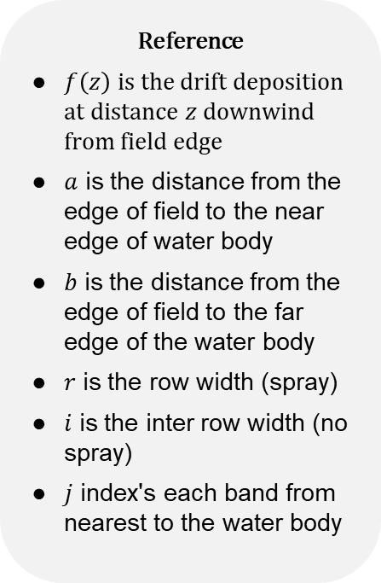
Theory – Parallel Bands, Novel Idea
Reference
$f\left(z\right)$ is the drift deposition at distance $z$ downwind from field edge
$a$ is the distance from the edge of field to the near edge of water body
$b$ is the distance from the edge of field to the far edge of the water body
$r$ is the row width (spray)
$i$ is the inter row width (no spray)
$j$ index's each band from nearest to the water body
In Words
To calculate the spray drift deposition for a banded application:
Calculate the drift for each band by subtracting the full field drift up the LHS of the band from the full field drift up to the RHS of the band
Sum all bands that have significant drift
$$a$$
$$b$$
$$r$$
$$i$$
$\overline{\begin{aligned}Parallel Banded \\ Drift\end{aligned}}$ = $\sum_{j=1}^{∞}{\left(\int_{a+\left(j−1\right)\left(r+i\right)}^{b+\left(j−1\right)\left(r+i\right)}{f\left(z\right)dz} − \int_{a+jr+\left(j−1\right)i}^{b+jr+\left(j−1\right)i}{f\left(z\right)dz}\right)}$
Near / Right Side
Far / Left Side
Notes:
- Now we can derive a formula for any given band, and by summing over all bands, we can derive this formula for banded drift for arbitrary:
- Water body dimensions
- Drift curve
- Row and inter-row widths *build*
- The first term is all the drift from the right side of the bands
- The second negative term is the drift from the left side of the bands

Slide 11
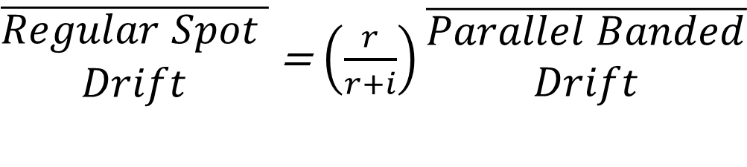




Theory – Regular Spot, Combine Parallel and Perpendicular
Scale drift from each Parallel banded by factor derived from Perpendicular banded
$\overline{\begin{aligned}Regular Spot \\ Drift\end{aligned}}$ = $\left(\frac{r}{r+i}\right)\overline{\begin{aligned}Parallel Banded \\ Drift\end{aligned}}$
$$r$$
$$r$$
$$i$$
$$i$$
Notes:
- Now for Regular spot, we mentioned at the start that it's the intersect of parallel and perpendicular banded. So combining the two methods is very easy.
- We can scale the drift coming from each parallel band by the % of each parallel band sprayed. The equation is linear so we can factor out scaling parameter, giving us this nice simple expression.

Slide 12
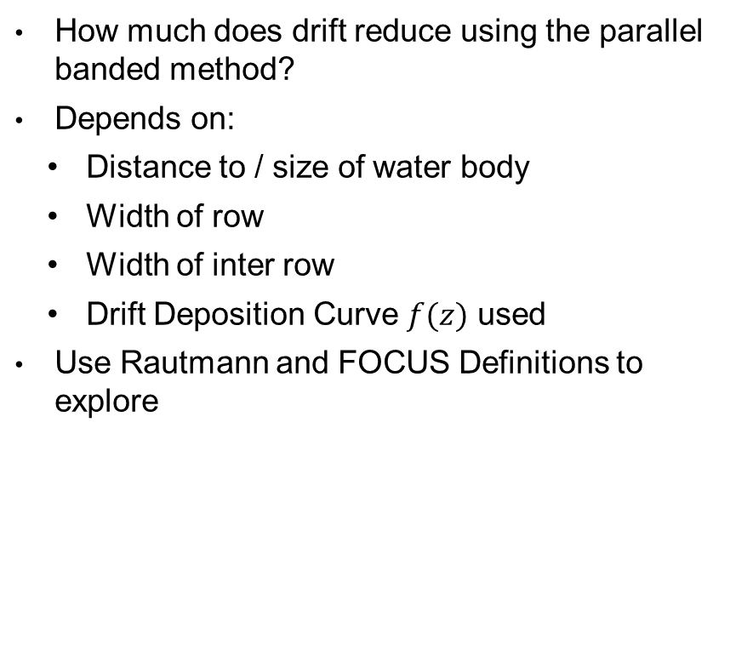
Exploration
How much does drift reduce using the parallel banded method?
Depends on:
Distance to / size of water body
Width of row
Width of inter row
Drift Deposition Curve $f(z)$ used
Use Rautmann and FOCUS Definitions to explore
High reduction from full field
Low reduction from full field
Different reduction for increased spray buffers and water body sizes
Notes:
- What kind of refinement can this give us?
- The refinement for banded and regular spot relies on
- the water body dimensions
- row and inter-row widths
- and the Drift Deposition Curve used
- Today i've picked the Rautman Drift Curves and the FOCUS definitions for water bodies and we can have a look at how much reduction we get.

Slide 13
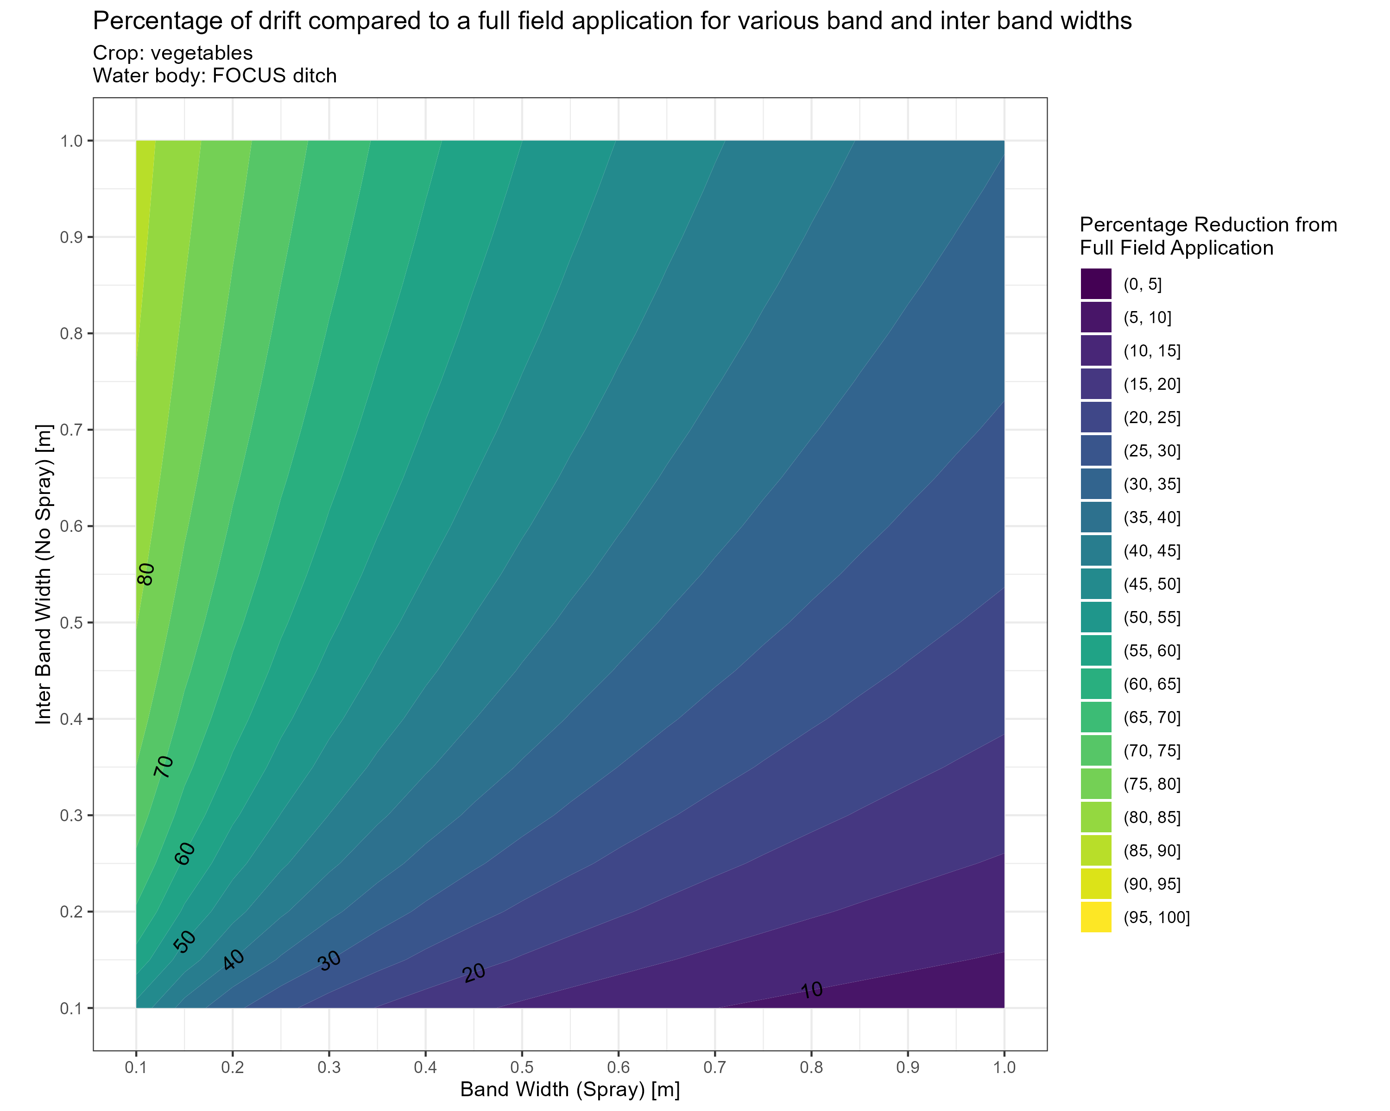
Exploration
Crop: Vegetables
Rautmann curve “Arable and veg sub 50cm”
Distance from crop to bank 0.5 m
Water body: “FOCUS Ditch”
Width 1m
Distance from bank to water body 0.5 m
Graphs have been created for:
Different geometries (distances and water body sizes)
Different drift curves (Pome, Aerial)
Notes:
- As an example, I've chosen the FOCUS definition of Vegetables, meaning it uses the Rautman "Arable and veg sub 50cm" curve with 50cm from the crop to the bank.
- ANd the FOCUS Ditch definition which means the water body is 1m wide and a further 50cm separates the bank from the water
- I'm using this as example, but I have these for all crops, all water bodies, and a few other Drift Curves
- On the right you can see a heatmap for various row and inter-row widths which plots the *% reduction in drift from a full field broadcast application*.
- As you'd expect, large row and small inter-row shows little reduction (maybe 10%) and the opposite shows a large reduction (up to around 80%)

Slide 14
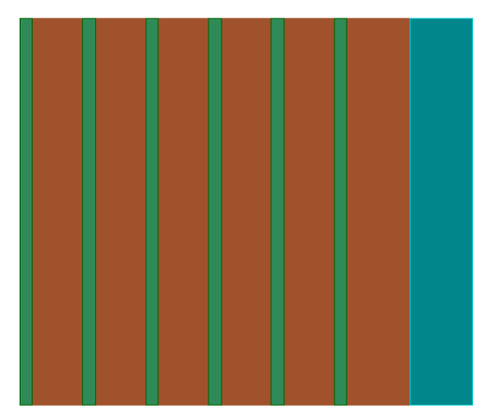
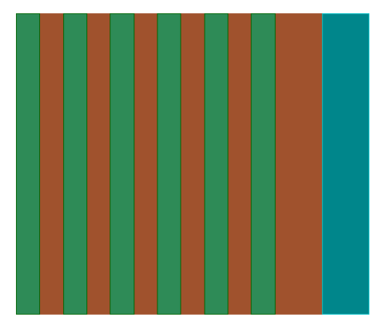
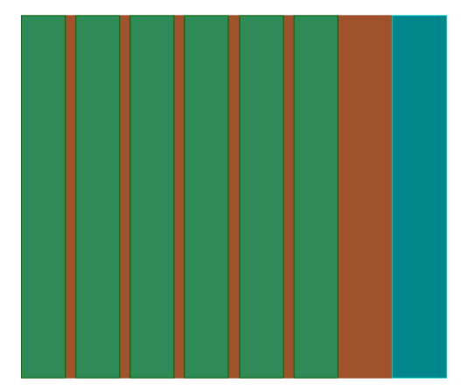
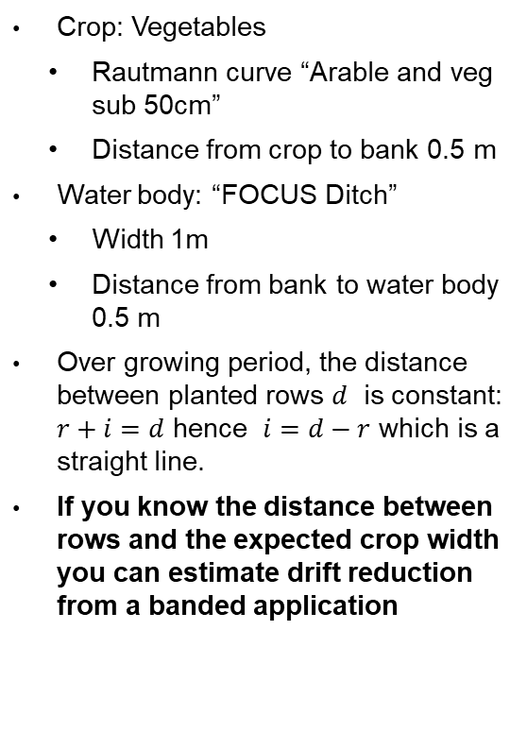
Exploration
Crop: Vegetables
Rautmann curve “Arable and veg sub 50cm”
Distance from crop to bank 0.5 m
Water body: “FOCUS Ditch”
Width 1m
Distance from bank to water body 0.5 m
Over growing period, the distance between planted rows $d$ is constant: $r+i=d$ hence $i=d−r$ which is a straight line.
If you know the distance between rows and the expected crop width you can estimate drift reduction from a banded application
Planting
Maturity
Notes:
- What's interesting is that you can plot a crop's growth cycle as line over this plot. Here I've made up theoretical crop where rows are 1.1m apart. As the crop grows, the row width to be sprayed grows and the inter-row shrinks the same amount.
- This means that drift refinement for banded applications can be made just by knowing the row spacing, and the expected diameter of a crop at various growth stages.

Slide 15
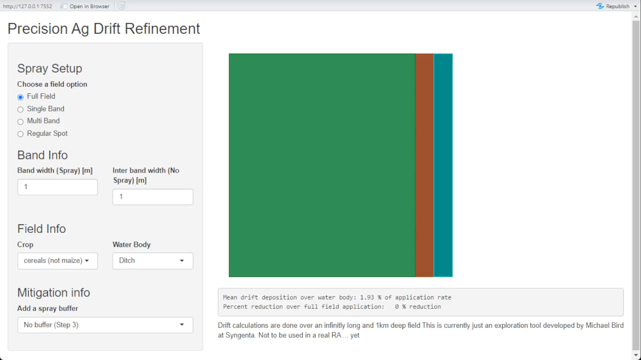

Next Steps – Explore yourself
Open-Source R Shiny app developed to enable exploration of potential spray drift reduction using these methods.
Web App
Github Link
Try it yourself!
Web App QR
Notes:
- I've made a publicly web-app for anyone to see the drift loadings and % reductions from the methods described today.
- In addition, the project repository containing all R code and the plots for other crops and water bodies is publicly available on Syngenta's GitHub.
- I am happy to help people with these, just email me

Slide 16
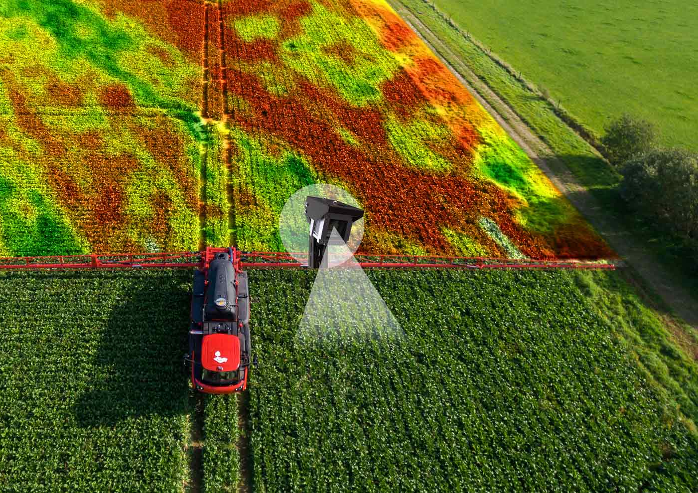
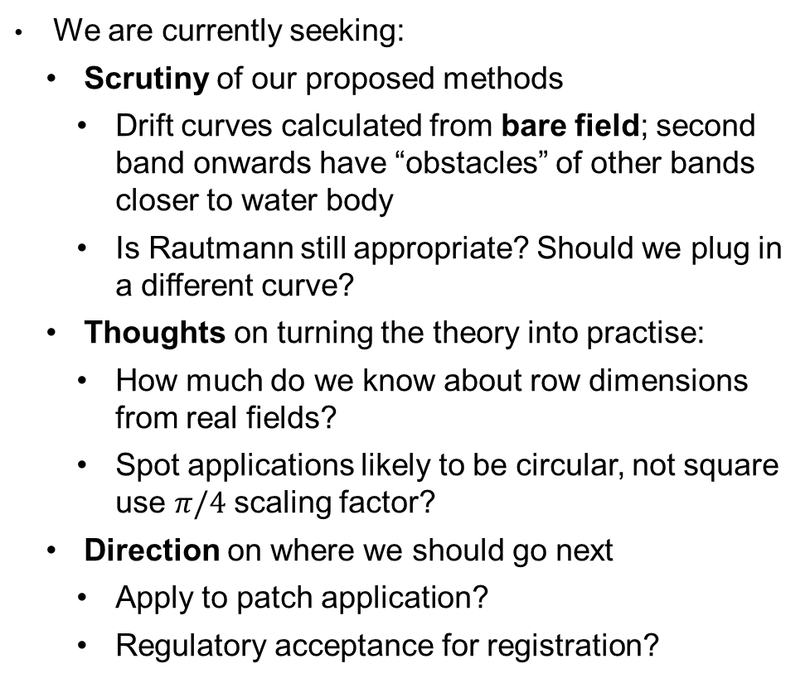
Next Steps – Application in Risk Assessment
We are currently seeking:
Scrutiny of our proposed methods
Drift curves calculated from bare field; second band onwards have “obstacles” of other bands closer to water body
Is Rautmann still appropriate? Should we plug in a different curve?
Thoughts on turning the theory into practise:
How much do we know about row dimensions from real fields?
Spot applications likely to be circular, not square use $π/4$ scaling factor?
Direction on where we should go next
Apply to patch application?
Regulatory acceptance for registration?
Moonshot idea - for predetermined spray maps (UAV imagery):
Discretise into many theoretical rows
Calculate spray drift
Adjust no-spray buffer as needed for acceptable drift loadings
Notes:
- Next steps, we want engagement, we want:
- Scrutiny of the method
- Thoughts on turning a theoretical approach to a practical RA tool
- Direction
- Is this something the UK would consider as a mitigation?
- On the right there is a moonshot idea of applying this method to patch application for a predetermined spray map. You could adjust this method to estimate the drift loading, then add spray buffer until the loading was acceptable to the RA.
- We know "Real time risk assessment" is a way off, but i think that's quite an exciting idea

